Slide 1





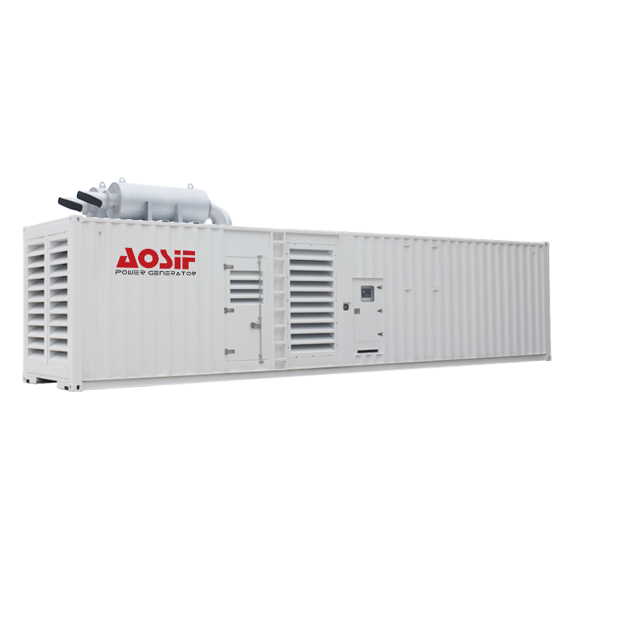
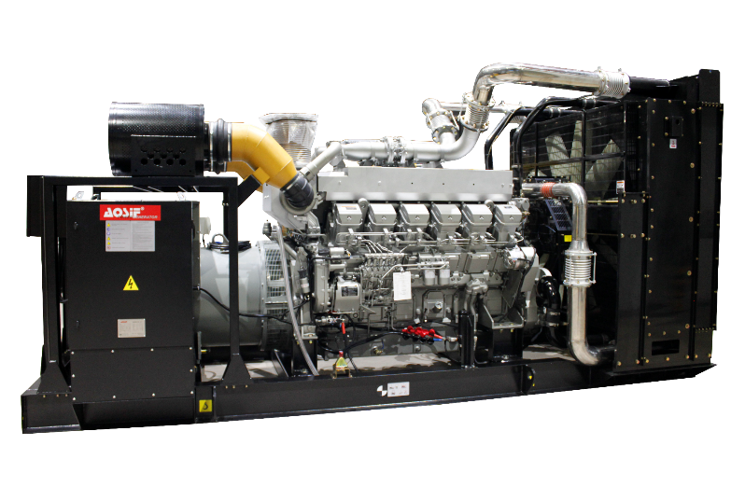
Model ASM2500 Generator set
AOSIF Mitsubishi Series
Product introduction
2500KVA/2000KW
XIAMEN AOSIF ENGINEERING LTD.

Slide 2

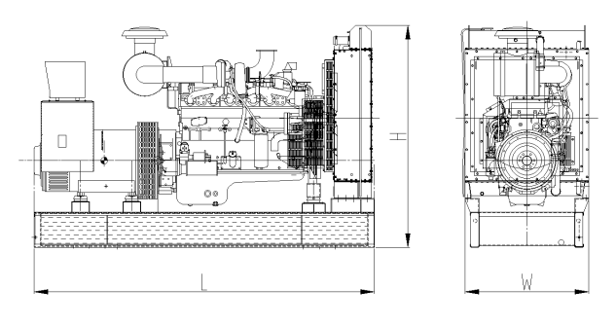
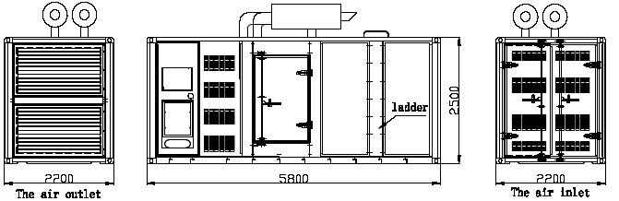
General Performance Data
Prime Power | 2250KVA/1800KW
Stand by Power | 2500KVA/2000KW
Frequency/Speed | 50Hz/1500rpm
Rated Power Factor(cosφ) | 0.8
Standard Voltage | 230V/400V
Phases | 3
Engine | Brand | Shanghai Mitsubishi
 | Model | S16R2-PTAW-C
Control module | Deepsea 7320
Rated Current | 3247A
Capacity of Breaker | 3600A
Starting Voltage | DC24V
Fuel consumption
Rated output | Fuel consumption rate
100%Standby | 201/KW.h | 512.4L/h
100%Prime | 203/KW.h | 468.1L/h
75%Prime | 209/KW.h | 361.5L/h
50%Prime | 218/KW.h | 251.3L/h
25%Prime | 233/KW.h | 134.3L/h
Standards followed
ISO9001 | ISO14001
ISO8528 | ISO12100
ISO13849 | EN12601
GB12786 | GB/T2820
IEC60034 | IEC60204
CE | RETIE
Dimensions and Weights
Type | Open | Silent
Length(mm) | 6310 | 7200
Width(mm) | 2210 | 2430
Height(mm) | 2620 | 2800
Weight(kg) | 14750 | 18350
Base fuel tank volume (L) | N/A | N/A
XIAMEN AOSIF ENGINEERING LTD.

Slide 3
Engine specification
Basic parameter
Manufacturer | shanghai Mitsubishi
Model | S16R2-PTAW-C
No. of cylinder | 16
Type | 4 cycle, 60°Vee
Prime Power | 1960kw /2627HP
Standby Power | 2167kw /2905HP
Induction system | Turbo-Charged, Air to Air Cooled
Governor | Electrical
Bore x Stroke | 170x220mm
Displacement | 79.90L
Compression ratio | 14.0:1
Oil Capacity(Total) | 290L
Coolant Capacity(Engine only) | 157L
Cranking Motor Voltage | DC24V
Fuel System
Type Injection system | Mitsubishi PS6 Type × 2
Min. Allowable flow of fuel to fuel pump | 512.4L
Air induction system
Maximum allowable intake air restriction
---with clean filter element | 4kPa
---with dirty filter element | 6.3kPa
Intake Air alarm temperature | 82℃
Exhaust system
Max. allowable back pressure | 6kPa
Standard exhaust pipe diameter | 280mm
Cooling system
Coolant capacity
---Engine only | 157L
---Total system | 453L
---With heat exchanger | 296L
Standard thermostat(modulating) range | 71-85℃
Max. coolant temerature | 98 ℃
Max. allowable top tank temerature for stand by/prime power | 104/100 ℃
Electric system
Min. recommended battery capacity (24V)
---10℃(50°F) & above- 0°F CCA | 400A
--- 0℃(32°F) to 10℃(50°F)- 0°F CCA | 400A
---18℃(0°F) to 0℃(32°F)- 0°F CCA | 600A
Max. allowable resistance of Starting circuit | 0.0015ohm
Starter(heave,Anode) | DC24V
Battery recharge system, negative ground | 35ampere
Lubrication system
Oil Pressure
---Idle speed | 200-300kPa
---Rated speed | 400-600kPa
Max. allowable oil temperature | 121℃
Oil Pan capacity - Low/High | 200 /260L
Total system capacity | 290L
Alternator specification
Phases | 3
Poles | 4
Power factor(cosφ) | 0.8
Winding connection | Star
Winding pitch | 2/3
Voltage regulator type | AVR
Coating | Vacuum impregnation
Insulation class | H
Protection | IP23
Excitation system | PMG
Bearing | Single Bearing
Coupling | Flexible disc
XIAMEN AOSIF ENGINEERING LTD.

Slide 4
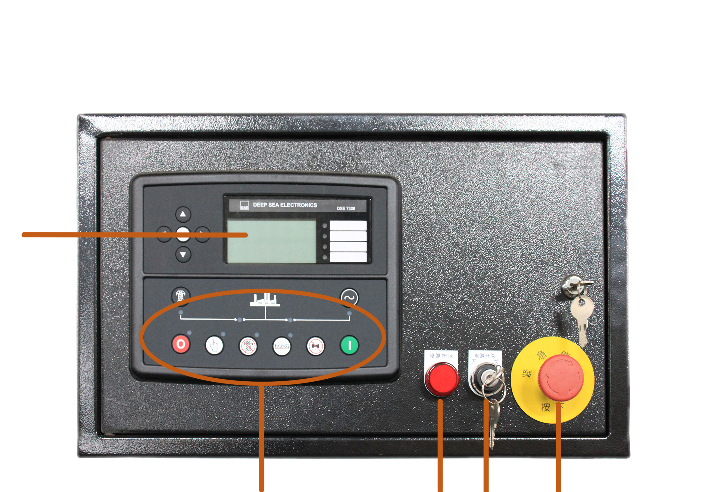
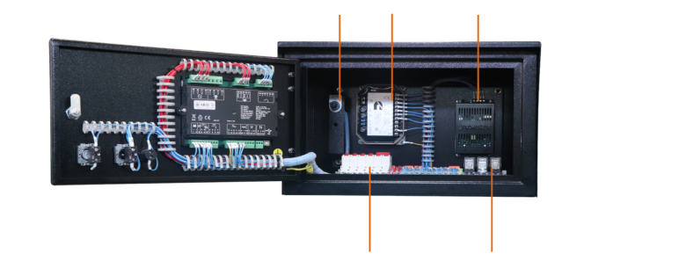
Control system Introduction
Deepsea 7320 Auto start & auto mains failure control panel
Key Features:
Deepsea 7320 is an auto mains failure controller for single generator, it can monitor and protect the generator working all the time. it has a LCD display which clearly shows the status of the engine. this controller include seven inputs and six outputs. This controller can also be programmed using the front panel or by using DSE configuration Suite PC software
● Multi language display
● Mains failure self starting
● The running time of the engine can be recorded to
facilitate the maintenance and repair of the unit
● User-friendly set-up and button layout
● LCD display can display multiple parameters at the
same time
● Support EFI engine
● IP65 rating (with optional gasket)
● PC and front panel configuration
● 100 event records
● Data recording and trend analysis
● Auto start/stop, load transfer and alarming
of generator
● Remote start on or off load
● With hierarchical loading function
● Multiple start/stop cycles can be preset
● 3 phase generator and mains voltage monitoring.
● Generator/load power detection(kW, kVA, kVAr PF)
● Overload protection (kW)
● Load current monitoring and protection
● Engine speed protection
● Engine pre-heat
● Engine start idle & stop idle
● Battery voltage monitoring
● Start under the low battery
● 8 configurable outputs
● 8 configurable input
●Integral PLC editor
● TIer 4 CAN engine support
● Data logging facility
● DSE2130,DSE2157,DSE2548 expansion module
can be connected
● Support 0-10V or 4-20mA oil pressure sensor
● Two sets of protection parameters can be preset
● Normal alarm, electrical trip and shutdown alarm can be
set to effectively monitor the engine speed,oil pressure,
water temperature and oil level, as well as the frequency,
voltage, current and power of the alternator, for
complete engine/alternator protection
● Low Oil Pressure
● High water Temperature
● High voltage and low voltage
● Overspeed
● Emergency stop
● Fail to start
①Emergency stop button
②Power switch
③Power indicator
④Operation buttons
⑤LCD display
⑤
④
③
②
①
⑥ ⑦ ⑧
⑨ ⑩
⑥Voltage and frequency trimmer | ⑨MCB
⑦Governor | ⑩Relay
⑧Charger
Main features:
Protection:
XIAMEN AOSIF ENGINEERING LTD.

Slide 5
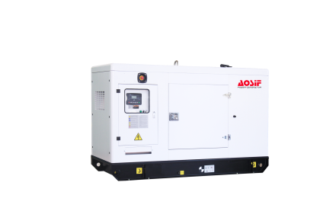
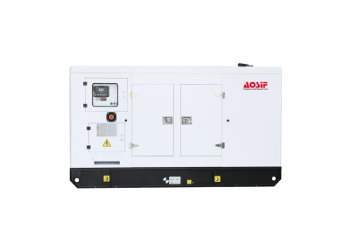
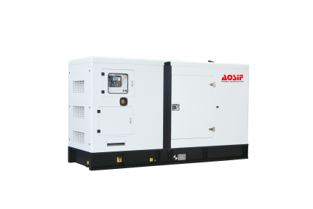
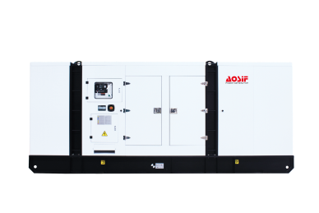
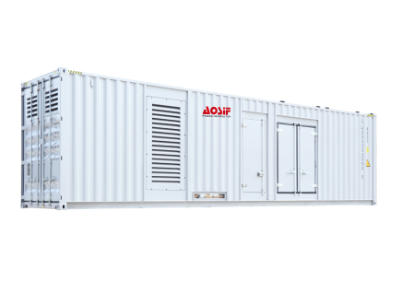
AOSIF Soundproof Canopy Introduction:
Standard Type：
● The arc angle structure makes the appearance beautiful and not easy to bump | ● The sufficient air in & out design ensure long-term and stable operation of the unit
● High quality coating powder, chemical surface treatment & 100-120um coating thickness greatly improving the anti- corrosion and anti rust level | ● Isolation net is designed for air inlet, exhaust outlet and muffler outlet to prevent objects from entering the unit
● Stainless steel hinge & door lock are beautiful and anti-rust | ● High density foam used inside effectively reduces noise
● 2.0mm cold rolled plate used makes the body more solid | ● Ceiling Lighting is equipped for easy operation
● The bottom forklift and loading port design enables easy loading and unloading | ● The built-in base fuel tank with fuel filler set on the shell facilitates refueling
● The drainage outlets are all connected to the outside for easy operation | ● Models above medium power range are designed with top hoisting mechanism to facilitate transportation of the unit.
Imitated container type：
● The shell is made of 3.0mm hot rolled steel plate so as to withstand the lifting capacity of 15-ton without deformation | ● The shell base is independent from the unit with 3mm thick checkered steel plate floor, which is beautiful & antiskid, and is convenient for overhaul & maintenance of the unit
● The switch cabinet and control panel are respectively set on both sides of the shell for easy maintenance & operation | ● The door handle, lock and hinge are all made of stainless steel to avoid rusting
● The shell looks similar to standard container, and can be loaded into 40HQ container for transportation, which is convenient for shipping | ● The air out louver made of the mesh plate with podwer coating and pasted with high-density glass fiber is beautiful and not easy to rust, and can further reduce the noise
● The lifting eye holes are designed on the top same as the standard container for easy handling | ● Isolation net is designed for air inlet, exhaust outlet and muffler outlet to prevent objects from entering the unit
● High density foam used inside effectively reduces noise | ● The sufficient air in & out design ensure long-term and stable operation of the unit
● The built-in base fuel tank with fuel filler set on the shell facilitates refueling | ● The drainage outlets are all connected to the outside for easy operation
● Double emergency stop button set on different surfaces enables quick response to operation requirements | ● Ceiling Lighting is equipped for easy operation
Standard container type：
● Can be shipped on board directly during transportation | ● The switch cabinet and control panel are respectively set on both sides of the shell for easy maintenance & operation
● The mesh plate with podwer coating and inner pasted with high-density glass fiber is installed inside the shell, which is beautiful and anti-rust, and can further reduce the noise | ● The air in & out louver made of the mesh plate with podwer coating and pasted with high-density glass fiber is beautiful and not easy to rust, and can further reduce the noise
● 3mm thick checkered steel plate floor is beautiful & antiskid, and is convenient for overhaul & maintenance of the unit | ● Isolation net is designed for air inlet, exhaust outlet and muffler outlet to prevent objects from entering the unit
● Double emergency stop button set on different surfaces enables quick response to operation requirements | ● The sufficient air in & out design ensure long-term and stable operation of the unit
● The independent daily fuel tank can be designed to put inside to meet requirements of continuous operation | ● The drainage outlets are all connected to the outside for easy operation
● The fuel filler is set on the shell to facilitate refueling | ● Ceiling Lighting is equipped for easy operation
XIAMEN AOSIF ENGINEERING LTD.

Slide 6
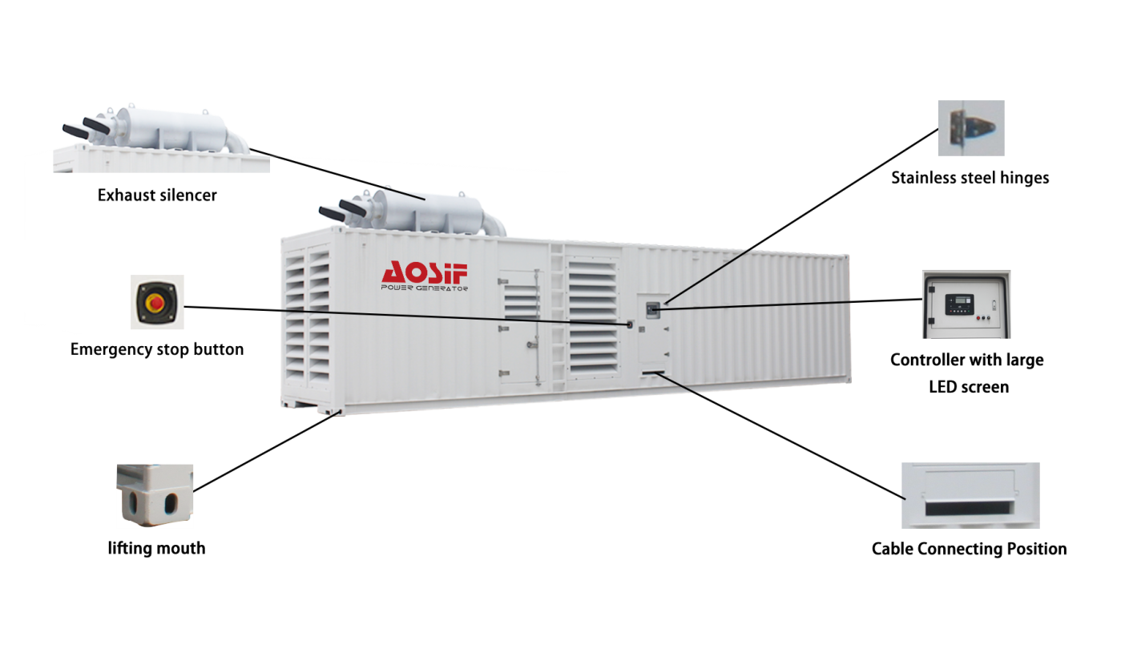

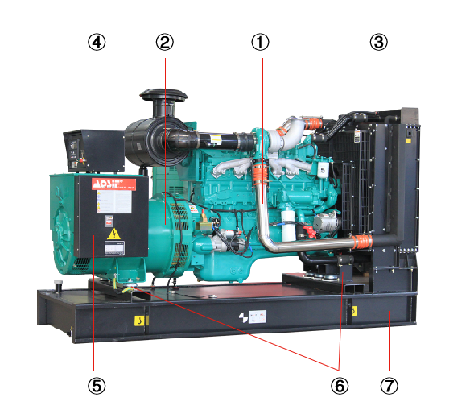
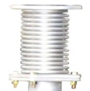
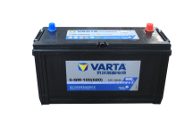
Decomposition diagram introduction of AOSIF Typical Canopy
Standard supply scope:
⑧
⑨
⑩
① Engine
② AC Alternator
③ Cooling Radiator
④ Auto Start Control Panel
⑤ Main Ciruit Breaker
⑥ Built in Shock Pad
⑦ High Strength Frame
⑧ Exhaust silencer
⑨ Bellow
⑩ Starting battery
Optional supply scope:
Genset | Engine | Alternator | Control system
● Tool box ● Base fuel tank ● External daily fuel tank ● Trailer | ● Fuel heater ● Fuel and water separator | ● Temp. detector for winding and bearing ● PMG ● Antirust, mildew and salt fog treatment ● Anti condensation heater | ● ATS ● Synchronization System ● Adjustable earth relay
Breaker | Fuel system | Lub-oil system | Cooling system
● ABB ● Schneider | ● Low fuel level alarm ● Auto Fuel Pump ● T Vlave | ● Lub oil heater ● Temp.-sensor ● Oil drain Pump | ● Elec.coolant Heater
XIAMEN AOSIF ENGINEERING LTD.

Slide 7
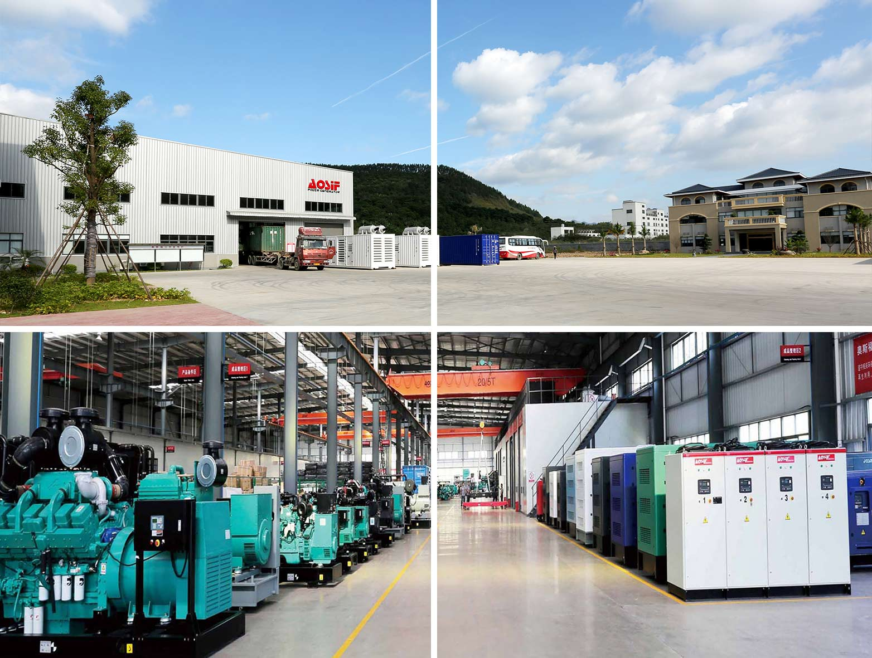




严格按保修条款提供免费保修服务
Our Promises
● AOSIF Engineering provides a full line of brand new and high quality products.
● Each unit passes strictly loading test in factory before shipment.
● Quality Warranty is provided strictly in accordance with warranty terms.
● Three level service guarantee: Aosif dealers, Service outlets of engine/alternator
manufacturers, Aosif service team.
XIAMEN AOSIF ENGINEERING LTD.
Marketing Center: Unit 1001,No.1 of Cheng Yi North Street,Software Park Phase III ,Xiamen ,China;
Factory: No.1088 Tangbian, Changtai Economic Development Zone, Zhangzhou,Fujian,China.
Website: www.aosif.com
You may get more information from our official account.
Specifications are subject to change without notice.

